Slide 1
Asymptotic structure in higher dimensions and its classification
Kentaro Tanabe
(University of Barcelona)
based on KT, Kinoshita and Shiromizu PRD84 044055 (2011)
KT, Kinoshita and Shiromizu arXiv:1203.0452

Slide 2
contents
Introduction
Asymptotic structure
Classification
Summary and Discussion
Notes:
Contents of my talk is following. At first I introduce the motivation of my research. Next I discuss the asymptotic structure in higher dimensions
and give a brief comment on its classification. Finally I summarize my talk.

Slide 3
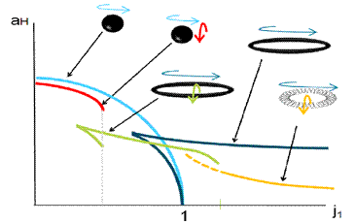
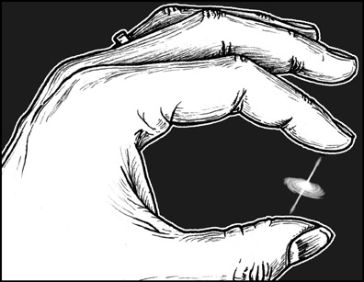
1. introduction

Slide 4
Higher dimensions
Understanding the physics of higher dimensional gravity
String theory predicts higher dimensional spacetimes
Possibility of higher dimensional black hole formation
in Large extra dimension and Tev-scale gravity scenario
It is important to reveal the difference of the gravity
between in four and higher dimensions
Notes:
My main research interest is a higher dimensional gravity. Why do we consider higher dimensional gravity ?
One reason is the string theory. String theory predicts that the spacetime should be higher dimensions not four dimensions.
Another reason is the Tev-scale gravity. In this scenario, higher dimensional black hole can be formed in collider such as LHC.
Motivated by these theories, higher dimensional gravity has been investigated all over the world.
In particular, it is important to reveal the difference of the gravity between in four and higher dimensions.

Slide 5
4 vs higher dimensions
There are many interesting properties in 4-dim gravity
4-dim
topology theorem
rigidity theorem
uniqueness theorem
positive mass theorem
stability of black holes
asymptotic structure
…..
Higher-dim
Notes:
Then, our task is the extension of the property of the four dimensional gravity to the higher dimensions. For example, topology theorem,
rigidity theorem, uniqueness theorem, positive mass theorem, stability of black holes and asymptotic structure and so on.
Since I do not have enough time to explain all things, for instance, I will pick up the uniqueness theorem.

Slide 6
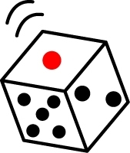
uniqueness theorem
Black hole
fundamental objects of gravitational theory
=
W. Israel
S. Hawking
B. Carter
…
uniqueness theorem (vacuum case)
Stationary, Asymptotically flat black holes without naked singularities are characterized by its mass and angular momentum. Its geometry
is described by Kerr spacetime.
collapse
Notes:
Uniqueness theorem is the theorem for the black hole solutions. Black hole is the fundamental object of the gravity theory. So,
since 70’s, many people have studied it. There are many interesting results and uniqueness theorem is one of the most remarkable achievement.
This uniqueness theorem was proven by Israel, Hawking, Carter, Robinson and Mazur. Its statement in the vacuum case is following.
Stationary, asymptotically flat black holes which has no naked singularity are characterized by its mass and angular momentum. And its
geometry is described by the Kerr metric. Kerr metric is given by this. M is mass and a is a specific angular momentum of the black hole.
This theorem means that if the cubic object as this collapse and become black hole, its form should be completely round without no edge like this.
This is a uniqueness theorem.

Slide 7
black holes in d>4
Uniqueness theorem does not hold in higher dimensions
In 5 dimensions
Myers-Perry BH
black ring
These objects can have same mass and angular momentum
Notes:
Then how about this in higher dimensions?
It is know that the uniqueness theorem does not hold in higher dimensions. Actually, in five dimensions, there can be
two or three solutions which have same mass and angular momentum. Thus we do not know the final form of this collapsing dice.
From this fact, the gravity has very different properties between in four and higher dimensions.

Slide 8
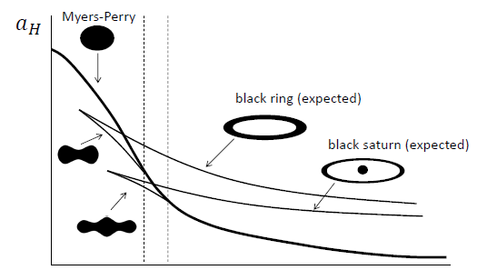
higher-dim gravity
Phase space of higher dimensional black holes
Higher dimensional gravity has rich structure
There are no systematic solution generating technique as in 4 and 5 dimensions
Notes:
This example is in five dimensions. In more higher dimensions, the situation changes more drastically. This is a phase space of highr
dimensional black holes. In five dimensions, there are only black hole and black ring. This and this. However, in more higher dimensions,
it is predicted and confirmed numerically that there is a pinched black hole like these. As seen in this, higher dimensional gravity
has very rich structure. However as a result we do not have nice technique to treat such rich structure, for example, systematic solution
generating technique. In four and five dimensions, we can construct the black hole solutions at will. Thus we want a new approach.

Slide 9
Asymptotic structure
Asymptotic structure:
view far from gravitational source
gravitational potential
radiation of energy and
angular momentum by GW
gravitational source
Application:
new suggestion to solution generating technique
( c.f. Petrov classification and peeling theorem, Kerr spacetimes )
Notes:
One possibility of this is a asymptotic structure. Asymptotic structure is a view point far from the gravitational source such as black hole.
In far region we can treat the black hole by its gravitational potential as Newton theory and dynamics of the black hole.
And there is an important application, which is a new suggestion to solution generating technique.
For example, it relate with Petrov classification through peeling theorem. Petrov classification played important role in
the discovery of Kerr solution.

Slide 10
Purpose
investigate the asymptotic structure in higher dimensions
determine the boundary conditions at infinity
derive the dynamics of spacetimes
reveal the asymptotic symmetry
study its classification i.e., relation with Petrov classification
Notes:
Then the purpose of my talk is the investigation of the asymptotic structure in higher dimensions.
In order to reveal the asymptotic structure, we should do following three things.
One is the determination of the boundary conditions at infinity. Secondly, we should study the dynamics of the spacetime.
Thirdly, clarification of the asymptotic symmetry.
After doing these, I will briefly comment on classification of the spacetime, in particular, Petrov classification.

Slide 11
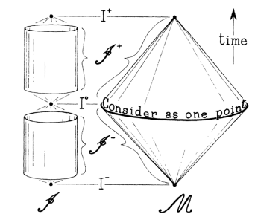
2. Asymptotic structure
Notes:
So I will discuss the asymptotic structure.

Slide 12
Asymptotic infinity
complicated non-linear and dynamical system
Asymptotic structure is defined at asymptotic infinity
gravitational source
how far from gravitational source ?
spacelike direction (spatial infintiy)
spacetime becomes stationary. c.f. ADM mass
gravitational potential can be calculated
null direction (null infinity)
spacetime is still dynamical but tractable c.f. Bondi mass
radiation of energy can be treated
Notes:
At first, asymptotic structure is defined at the asymptotic infinity. At infinity, the gravity becomes very simple and tractable even if
the gravitational source is very complicated and its dynamics is non-linear.
There two infinities of spacetimes. As a remark, I consider the asymptotically flat spacetime in this talk.
One is a spacial infinity, which is infinitely far from source along spacelike directions. At spatial infinity, the spacetime
become stationary and we can compute gravitational potential of the source such as ADM mass.
Another infinity is a null infinity, which is infinity along null directions. At null infinity, the spacetime is still dynamical but
its dynamics is tractable. At null infintiy we can compute the radiation of energy and momentum.
In this talk we cosider null infinity.

Slide 13
null infinity
null infinity
gravitational waves can reach at null infinity
future null infinity : $t →∞, r →∞ (t−r :fixed)$
asymptotic structure
contains all dynamical information such as radiations of energy and momentum by gravitational waves
Notes:
As mentioned, the spacetime is dynamical at null infinity. This is because the gravitational waves can reach at null infinity.
Null infinity is located roughly at the point where t and r goes infinite with its difference fixed. Then, the metric of the
asymptotically flat spacetime should became like this. eta is the flat metric and h represents the deviation from flat metric.
this h is the asymptotic structure and contains all dynamical information of the spacetime. Naively, h is gravitational waves.
Thus to investigate the asymptotic structure, we should impose the proper boundary conditions.

Slide 14
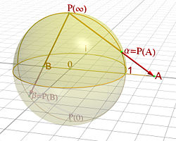
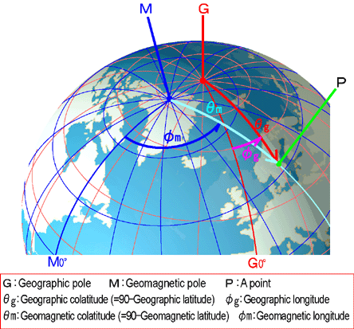
define “infinity”
There are two methods to define the infinity
conformal embedding method
using conformal embedding
infinity is defined as a point $Ω=0$
coordinate based method
explicitly introducing the coordinate
Coordinate based method is more adequate for null infinity
Notes:
There two methods to define infinity and impose the boundary conditions.
One is the conformal method, where we use the conformal embedding of the spacetime like riemann sphere like this.
Another is a coordinate based method. Here I use this coordinate method and explicitly introduce the coordinate
so called Bondi coordinate. In higher dimensions, in particular in odd dimensions, the conformal method is not useful.

Slide 15
strategy
The strategy to investigate the asymptotic structure at null infinity is as follows:
defining the asymptotic flatness at null infinity
investigating the dynamics of spacetimes
studying the asymptotic symmetry
introducing the Bondi coordinate and solving Einstein Eqs.
determining the boundary conditions
defining the Bondi mass and angular momentum
deriving the radiation formulae
to check the validity of our definitions of asymptotic flatness
Notes:
Our strategy to investigate the asymptotic structure at null infinity is as follows.
At first, introducing the Bondi coordinate, we impose proper boundary conditions and define asymptotic flatness at
null infinity. Next, we investigate the dynamics of the spacetime such as definition of the mass of spacetime
and radiation formula of the energy. Finally we study the asymptotic symmetry. This is to check the validity of
our definiton of the asymptotic flatness, that is, our bounday conditions.

Slide 16
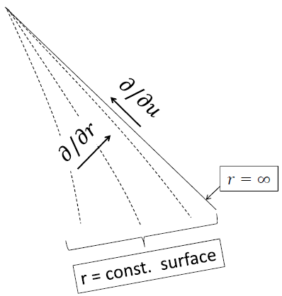
bondi coordinate
Bondi coordinate
gauge conditions
$u=u_{0}$ is a
null hypersurface
Notes:
Let us introduce the Bondi coordinate. We impose three gauge conditions. One is like this. This means that the u-constant hypersurface
should be null hypersurface. By this condition we have u as time coordinate. Next we introduce the angular coordinate x^I which should
become independent of u like this. And the radial coordinate r is defined as area raidus as this. Schematic picture become like this.
Then, in this coordinate, we call Bondi coordinate, the metric can be written like this. Under these gauge conditions, free functions
of the metric are A, B, U^I and h_IJ.

Slide 17
Einstein equations
to investigate the asymptotic structure at null infinity,
let us investigate the structure of Einstein equations
Einstein equations are decomposed into:
constraint equations
evolution equations
( equations without u-derivatives )
extracting the degree of freedom
( equations with u-derivatives )
describing the dynamics of spacetimes
Notes:
To reveal the asymptotic structure at null infinity, we should solve the Einstein eqautions. Einstein equations can be classified into
two classes. One is constraint equation which has equations without u-derivative. And another is an evolution equation,
which contain the equation with u-derivative. Constraint equation is used to extract the degree of freedom of the gravity.
The evolution equation describes the dynamics of the spacetime.

Slide 18
constraint eq
constraint equations become…
Notes:
In this Bondi coordinate, the constraint equation becomes like this. These equations contains no u-derivative. prime denotes r-derivative.
rr componente says the function B can be written by h. the trace part of ricci tensor and rI componets become like these. From these equations,
the function A and U^I are obtained using h_IJ. Thus, in the Bondi coordinate, the function A, B and U^I has no degree of freedom and
only h_IJ is a free function on the intial urface. But these equations are differencial equations, so, there are integration functions.
Such integratio functions are also free functions on the initial surface.

Slide 19
evolution eq
evolution equations become…
Notes:
Thus the we need evolution equations for h_IJ only. The evolution equation is contained in IJ component of the Einstein
equation like this. The dot denote the u-derivative. This equation describe the dynamics of the spacetime.

Slide 20
asymptotic flatness
The asymptotic flatness in d dimensions is defined as
round metric on $S^{d−2}$
c.f.
Notes:
Under this situation, we define asymptotic flatness at null infinity. From the constraint equations, we should consider only h_IJ.
The boundary conditions on A, B and U^I are determined by the constraint equations. Then, we define asymptotic flatness
at null infinity in d dimensions by the boundary conditions like this. Here omega_IJ is the round metric on d—2 dimensional sphere.
This boundary conditions can be understood from wave equation in d dimensions. Wave equation in d dimensions has the
solution like this order in far region. The gravitational wave is also wave and we can expect h_IJ represents the gravitational wave, so
this condition is natural.

Slide 21
boundary condition:
Notice: total derivative term !!
constraint equations
Notes:
The boundary conditions on other metric functions can be obtained from constraint equations. Let expand h_IJ at null infinity
like this. r=infinity is the null infinity. From constraint equation, we get the behaviour of the other etric functions like this.
A^k and U^k can be written using h^k like this. m and j^I is the integration function as mentioned, so free functions on initial surface.
It is easy to notice that m and j^I correspond to the order of ADM mass nad angular momentu in d dimensions.

Slide 22
bondi mass
The Bondi mass is defined using $g_{uu}$
total derivative
integration function
Notes:
Then we define the Bondi mass using function m. m is contained in g_uu which is lapse. The Bondi mass is defined as like this. The
coefficient was determined so that at spatial infinity this becomes ADM mass. The Bondi mass describe the energy and momentum
contained in the spacetime.

Slide 23
bondi angular momentum
The Bondi angular momentum is defined using $g_{uI}$
total derivative
integration function
Killing vector：
Notes:
In the same way, we define the Bond angular momentum. using the integration function j^I. j^I is contained in g_uI
which is shift. Then the Bondi angular momentu is defined as this. The coefficients is determined in the same way as Bondi mass.
Here m^I is the Killing vector of the metric omega_IJ, which is the background metric.

Slide 24
radiation
Bondi mass and angular momentum defined as the free functions on the initial surface $u=u_{0}$
gravitational waves
These quantities are radiated by gravitational wave
$$u=u_{0}+Δu$$
$$u=u_{0}$$
The evolutions are determined by Einstein equations
Notes:
We defined asymptotic flatness at null infintiy and Bondi mass and angular momentum. Next task is to investigate
its dynamics using the evolution equations. Bondi mass and angular momentum are defined using the free function on initial surface.
Its evolution is determined by Einstein equations. Thus, setting the Bondi mass and angular momentum on the initial surface,
then, at next step, those quantities evoloves by the radiation of the gravitational waves.

Slide 25
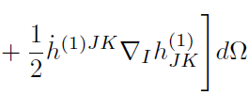
radiation formulae
under the boundary conditions
gravitational wave
Einstein equations give
energy of GW
angular momentum of GW
Notes:
Then under the boundary condition of this, the Bondi mass and angular momentum are radiated by the gravitational waves
like this. where h^1 is the leading part of h_IJ and describe the gravitational waves. These equations are radiation formulae.
The radiation formula of Bondi mass implies that the gravitational waves always carry out the positive energy. This is because this term
is exactly square of h^1. The angular momentum can become positive and negative because it has a direction.
This equations teach us how we can estimate the energy and momentum of the gravitational waves in d dimensions.

Slide 26
asymptotic symmetry
Asymptotic symmetry is a global symmetry of the asymptotically flat spacetime
Asymptotic symmetry group is the transformations group which
preserve the gauge conditions of Bondi coordinate
do not disturb the boundary conditions
Notes:
Next we consider the asymptotic symmetry. Asymptotic symmetry is the global symmetry of the spacetime at null infinity.
Asymptotic symmetry is defined as the transformation group which preserve the gauge conditions of the Bondi coordinate
as these, and do not disturb the noudary conditions of the asymptotic flatness like this. The coordinate transformation
which satisfy these two conditions is the asymptotic symmetry transformation. We can say that this is a residual gauge of the
Bondi coordinate in asymptotically flat spacetime. .

Slide 27
generator
transformation：
gauge conditions
generator
boundary conditions
only in d>4
conformal group on $S^{d−2}$
= $SO(1,d−1)$
$f$ is the harmonic function of $l=0$ or $l=1$ on $S^{d−2}$
= translation group
Notes:
Let us see detail. Coordinate transformation can be written using the genereator xi like this. Then by imposing the gauge conditions
of the Bondi coordinat, we can get the explicit form of the generator of the asymptotic symmetry like this. Generator is parametrized
by the function f and f^I. Next imposing the boundary condition, we can get the condition on f and f^I. The conditions on f^I are
like this. These conditions implies that f^I is a generator of the conformal Killing on d-2 dimensional sphere. This equation
is the conformal Killing equation. Thus, it transformation group is SO(1,d-1). On the other hand, the condition on f means that
f should be the harmonic function of l=0 or l=1 on d-2 dimensional sphere. Thus f has four modes. But this is the case only
in higher dimensions. In four dimenisons, there is no conditons on f as comment on later.

Slide 28
poincare group
The asymptotic symmetry group is the semi-direct group of $SO\left(1,d−1\right)$ (Lorentz group) and translation group
= Poincare group
Actually, Bondi mass and angular momentum are transformed
covariantly under the Poincare group
$$∂/∂u$$
At null infinity the spacetime is dynamical.
During translations, energy and momentum are radiated by gravitational waves
translation
Notes:
Then, the asymptotic symmetry group is generated by f and f^I. And This means that the asymptotic symmetry group
is the semi-direct group of the SO(1,d-1) and translation group, that is, Poincare group in higher dimensions. Thus we can treat the
gravitational fields as the deviation from flat spacetime covariantly. Furthermore, the Bondi mass and angular momentum
are transformed covariantly by the asymptotic symmetry like this. This is transformation under translation, for instance.
Here, because at null infinity, the spacetime is dynamical, there are contributions from gravitational waves. Thus during the translation,
energy and momentum are radiated like this. However remaining terms describes the famous Poincare transformation.
This fact iplies that our boudnarycondition and definition of the Bond mass and angular momnetum are valid one..

Slide 29
subtle in 4-dimensions
In four dimensions, we cannot extract translation group
generator
boundary conditions
there are no conditions on $f$
conformal group on $S^{2}$
= $SO(1,3)$
arbitrary function on $S^{2}$
infinite degree of freedom
supertranslation
Notes:
In four dimensions, there is a subtle. Imposing the gauge condition and boudary condition, we can extract the Lorentz group from f^I as in
higher dimensions, but we cannot obtain the translation group because there is no condition on f. Thus f is an arbitrary function on S^2.

Slide 30
supertranslation
Asymptotic symmetry group
infinite dimensions group
Lorentz group $⋉$ supertranslation
under supertranslation
radiation by gravitational waves
contribution of supertranslation
This is because
gravitational waves
4-dim
(super)translation
$$O(1/r^{d−2/2})$$
$$O(1/r)$$
Notes:
Thus the asymptotic symmetry in four dimensions is the semi-direct group of Lorentz group and infinite dimensional group, so
called supertranlation. Then, under supertranslation, for example, Bondi angular momentum has contributions of gravitational waves
and supertranslation. These contributions cannot be distinguished. The supertranslation term is symmetry and it is a gauge, so we
cannot separate the gauge freedom from the radiation parts. Thus in four dimensions, we cannot investigate the angular momentum
radiation using only asymptotic structure at null infinity. There are further information such as the position of the origin of the coordinate.
This is because the gravitational wave contribution and supertranslation contribution has same order in four dimensions. In four dimensions,
gravity is too weak to

Slide 31
short summary
determined the boundary conditions at null infinity
derived the radiation formulae
clarified the asymptotic symmetry and difference
between in four and higher dimensions
In this analysis, we obtained the general radiated metric in d dimensions. This is useful to classify the spacetime.
Notes:
Let us summarize shortly. We defined asymptotic flatness and Bondi mass and angular momentum at null infinity.
And we derived the radiation formulae. Further revealed the asymptotic symmetry is a Poincare group.
And we find there is a difference between in four and higher dimensions.

Slide 32
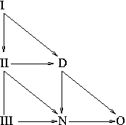
3. classification
Notes:
Finally we consider the classification of the spacetime.

Slide 33
classification
How can we classify general spacetimes?
in four dimensions:
Algebraically classification = Petrov classification
Asymptotic behavior Classification = Peeling property
decompose Weyl tensor into 5 complex scalars
typeD contains all black holes solutions
perturbation equations are decouple
Notes:
So how can we classify the general spacetimes?
In four dimensions, there are two approach. One is the algebraically classification,
so called Petrov classification. Another is a asympeotic behaviour classification, which is a peeling property.
In Petrov classification, we decompose the Weyl tensor into five scalars using null tetrad. Then, the spacetime
is classified with non vanishing Weyl scalars. For example, type D class contains all black hole solutions.
Using this Petrov classification, many interesting solution were constructed, such as Kerr metric and C-metric.
Furthermore, the perturbation equation of Weyl scalar becomes decouple, so it is useful to study the stability
of the black hole solutions. In Peeling property, The spacetime is classified the asymptotic behaviour of the Weyl tensor like this.

Slide 34
petrov vs peeling
In four dimensional asymptotically flat spacetimes, two classifications are identical
Petrov classification = peeling property
type N
typeⅢ
type Ⅱ,D
type Ⅰ
Petrov classification is very useful for constructing new solutions and investigating dynamics of the solutions
Notes:
Then in four dimensions, there is a remarkable relation of Petrov classification and Peeling property.
Indeed, these two classifications are identical in asymptotically flat spacetimes.
Thus, all Petrov type has different asymptotic behaviour of the Weyl tensor like this. As a result, the classification
method of the asymptotically flat spacetime is unique. From the usefulness of this classification, wee would like to extend this
classification to higher dimensions.

Slide 35
petrov in higher dimensions
Petrov classification is extended to higher dimensions
Weyl tensor is decomposed into some scalar functions and
spacetime is classified by non vanishing Weyl scalars
G
Ⅰ
Ⅱ
Ⅲ
c.f. 4-dim
D
N
O
Type G (general) has no WAND( principal null direction in 4-dim )
Notes:
There are many work about the Petrov classification in higher dimensions. As in four dimensions, Weyl tensor is
decomposed into several scalar functions using null tetrad and the spacetime is classified with non vanishing Weyl scalar.
The result becomes this figure. The difference from four dimensions is the appearance of typeG. In general, in higher
dimensions, there is no principle null directions as in four dimensions and such spacetime is typeG. Other Petrov
type are same as in four dimensions.

Slide 36
difficulty in petrov
Petrov classification is not so useful as in 4 dimensions
cannot solve Einstein equations of type D
perturbation equations are not decouple in general
Goldberg-Sachs theorem does not hold
Null geodesic has non vanishing shears and cannot be used as coordinate as in four dimensions.
As a result Einstein equations become complicate.
G
Ⅰ
Ⅱ
Ⅲ
D
N
O
Notes:
Furthermore, there are some difficulties in higher dimensional Petrov classifications.
One is about the construction of the solutions. As in four dimensions, we cannot solve the Einstein eqaution of typeD or II.
One reason of this is that the Goldberg-Sachs theorem does not hold. Thus the null geodesic has non vanishing shear. We cannot using
null geodesic as the coordinate and the Einstein equations become very complicate.
Another aspect is that the perturbation equation are not decouple in general. In higher dimensions, gravity has many degrees of
freedom. Sp, unlike in four dimensions, the perturbation equations are not tractable.

Slide 37
peeling in higher dimenisons
Then, how about peeling property ?
Ⅰ
Ⅱ
Ⅲ
D
N
Using our result of asymptotic structure,
O
$C_{μνρσ }= \frac{1}{r^{d−2/2}} C_{μνρσ}^{(1)}$ + $\frac{1}{r^{d/2}} C_{μνρσ}^{(2)}$ + $\frac{1}{r^{d+2/2}} C_{μνρσ}^{(3)}$ +….
type N
more than type Ⅱ
less than type Ⅲ
type G
$${\sim \ddot{h}}_{IJ}$$
gravitational waves
Petrov and peeling has no correspondence in higher dimensions?
Notes:
Then how the relation with peeling property becomes? Using our result, it is easy to study the asymptotic behaviour of the Weyl tensor.
This was done by Reall and his student and the result become as follows. The asymptotic behavior of Weyl tensor become like this
in d dimensions. And Each class of Petrov type becomes like this. Thus, unlike in four dimensions, it seems that there is no relation
of Petrov classification and peeling property.

Slide 38
possibility
There are two possibilities:
Petrov and peeling has no correspondence completely
Petrov and peeling has correspondence partly
Classification due to peeling property can be useful to construct new solutions and study perturbations.
There may be a correspondence when the class is restricted, for instance, to typeD (or II) which contains black holes solutions
Notes:
However, there are two possibilities. One is there is no correspondence completely. This means that there are different classification
of higher dimensional spacetimes. Since the Petrov classification is not so useful in higher dimensions, in this case, we can expect
that the classification by peeling property can be useful to construct new solutions or study the stability of the black holes.
Another possibilities is there is a partial correspondence. In this case, for example, there is a correspondence only in type D or II.
In either cases, we should investigate the relation of these classification furthermore. Such study can give the new solution
generating technique of higher dimensional black hole solutions.

Slide 39
4. summary and discussion

Slide 40
summary
We investigated the asymptotic structure at null infinity
determined the boundary conditions
defined the Bondi mass and angular momentum, and derive the radiation formulae of those
revealed that the asymptotic symmetry is the Poincare group in higher dimensions
studied the relation of Petrov classification and peeling property in higher dimensions

Slide 41
future work
Classification using peeling property
Only type N (radiation spacetime) has been investigated.
type D(or II) which contains black hole solutions should be studied
restricting to asymptotically flat spacetime
Generalization to matter fields (i.e. gauge fields) of our result

