Slide 1
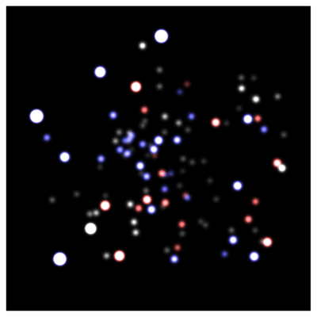
Energy extraction from black holes
BHs2011 19-20 Dec 2011 | Aveiro, Portugal
Credit: ESO/MPE (2010)
Vitor Cardoso (CENTRA/IST & Olemiss)
Notes:
LIGO-G080249-00-Z
1
1

Slide 2
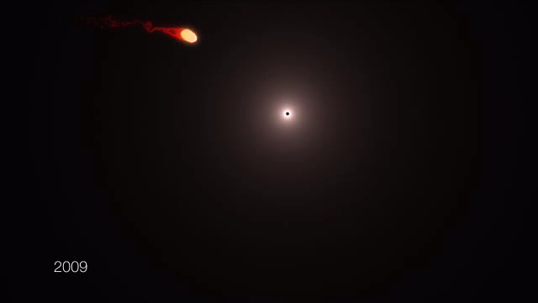
Credit: ESO/MPE/M.Schartmann (2011)

Slide 3
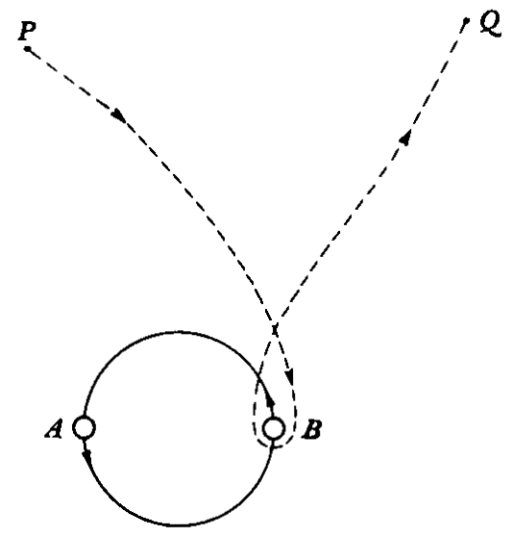
Orbital energy: slingshot effect
Notes:
3

Slide 4
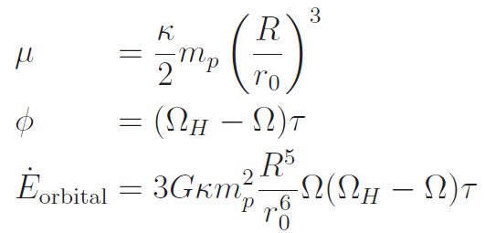
Rotational energy: tidal acceleration

Slide 5
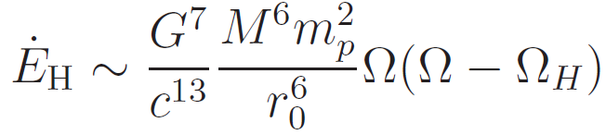
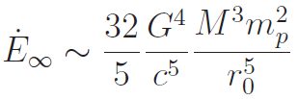
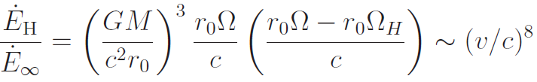
Tidal acceleration is in general impossible for BHs!
Press & Teukolsky, Nature (1973)

Slide 6

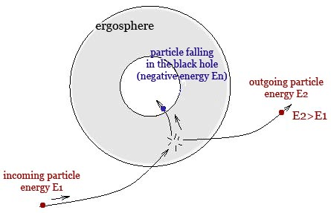
Ergo-region: asymptotic time-translation Kiling vector is space-like
  Penrose process
  Superradiance
  Hawking radiation
Notes:
6

Slide 7
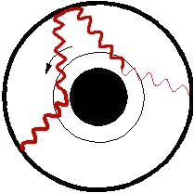
Insert a mirror around the BH
anti-de Sitter
Make a “bomb”!
(Zel’dovich, 1971; Press & Teukolsky 1973)
Small Kerr-AdS BHs are unstable
(Cardoso & Dias ‘04; Kodama ’07;
Uchikata, Yoshida & Futamase ’09)
Notes:
7

Slide 8
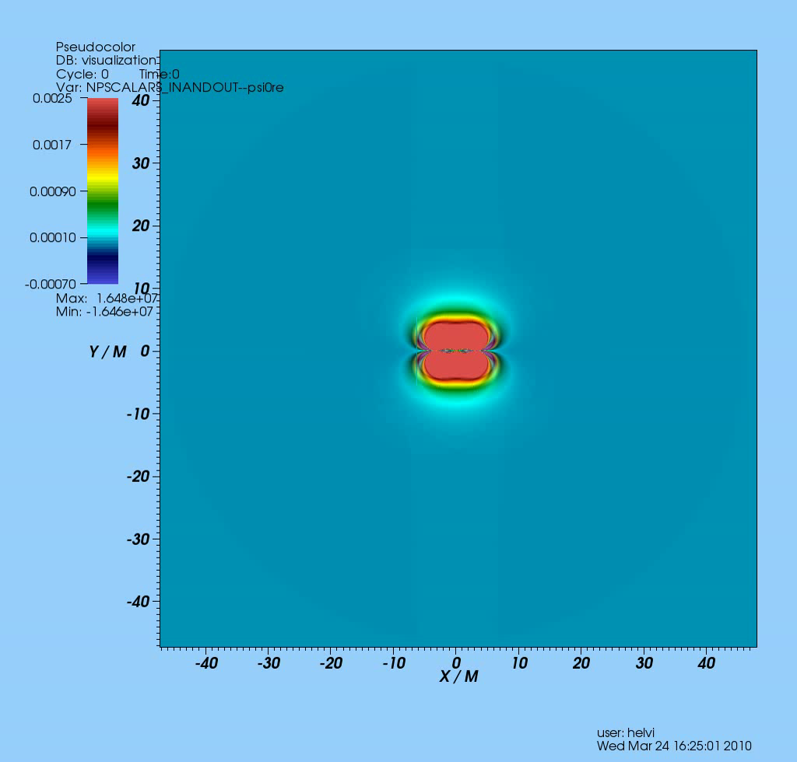
(Witek et al, ‘10)

Slide 9
Horizonless geometries?
Theorem (Friedman, 1978):
Every stationary, AF, horizonless spacetime with an ergoregion is unstable
(Intuition: negative-energy states are amplified, no horizon to absorb them)
Gravastars (Mazur & Mottola ‘01)
Boson Stars (Kaup ’68; Ruffini & Bonazzola ‘69)
Wormholes (Morris & Thorne ‘88)
Superspinars (Gimon & Horava ‘09)
Ergoregion instability rules out “all” of these!
(Cardoso et al, ’08; Pani et al ‘10;)

Slide 10
Resonant excitation of BH modes? Resonant tides?
Massless modes of BHs are localized around the light ring...
...and the null geodesic lies inside the ISCO

Slide 11
(massive) scalar fields
Interesting as effective description
Proxy for more complex interactions
Arise as interesting alternatives of GR
  Brans-Dicke or generic scalar-tensor theories; quadratic f(R)
  GW spectrum encodes the gravity theory
Axiverse scenarios (moduli and coupling constants in QCD, Peccei-Quinn mechanism QCD, etc)

Slide 12
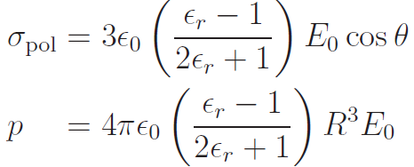
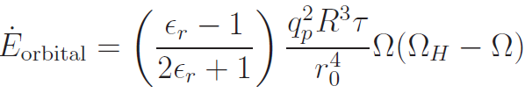

Slide 13
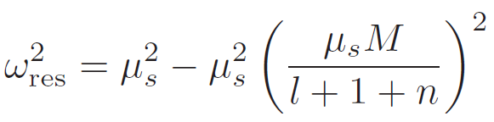
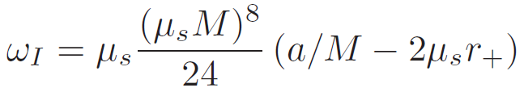

Slide 14
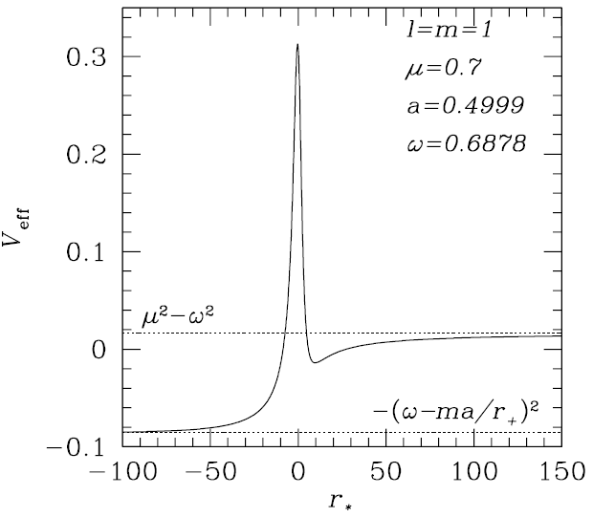
Massive fields
Massive fields around Kerr are unstable
(Damour et al ‘76; Detweiler, ’80; Cardoso & Yoshida ’05; Dolan ‘07)
Notes:
14

Slide 15
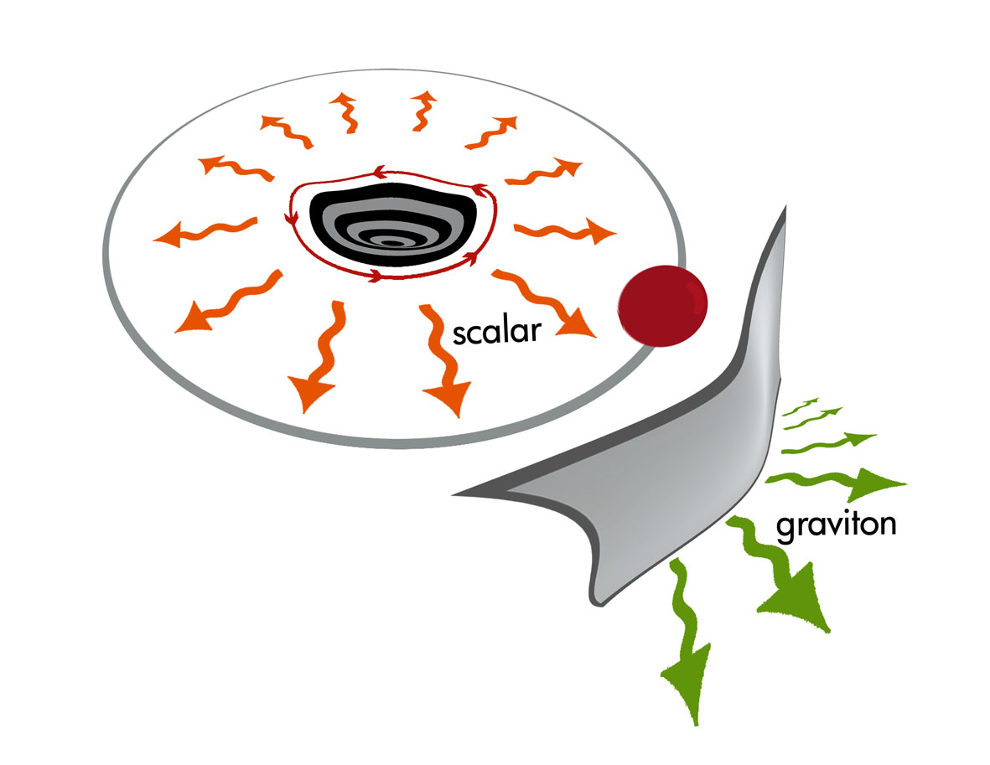
Floating orbits
Cardoso et al, PRL107:241101, 2011

Slide 16

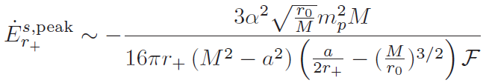

Slide 17
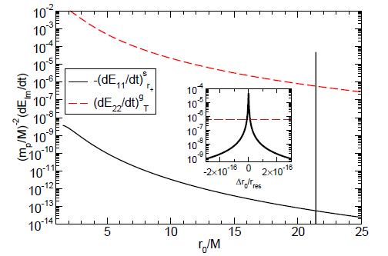

Slide 18
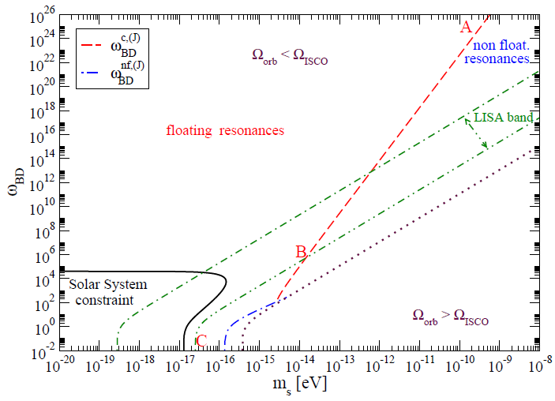

Slide 19
Tidal acceleration is equivalent to superradiance in BH physics
✴
In absence of other dissipation mechanisms, tidal dissipation leads to floating orbits
✴
Floating orbits can be instrumental to constrain or prove existence of massive scalars coupled to matter... still a lot to do
Notes:
LIGO-G080249-00-Z
19

Slide 20
Thank you
Cardoso, Chakrabarti, Pani, Berti, Gualtieri, PRL107: 241101 (2011)
Yunes, Pani, Cardoso, arXiv:1112.3351
Cardoso, Pani, in progress (2012)
____________________________
✴
____________________________

